Slide 1


REVIEW OF RESEARCH PAPER
Corrosion of Steel Fibre Reinforced Concrete from the Cracks (2005)
- By Jean-Louis Granju & Sana Ullah Balouch
Published In:
Cement and Concrete Research
NAME: M HEMA VARSHNI
YEAR & DEPT: 3rd Year Civil Engineering|
GUIDE NAME: Dr.Keerthana Kirupakaran

Slide 2
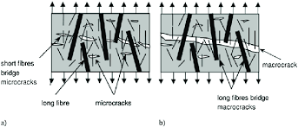
INTRODUCTION
Steel Fibre Reinforced Concrete (SFRC) is widely used because fibres improve crack control and provide post-cracking load carrying capacity.
Although SFRC behaviour under short-term loading is well understood, its long-term durability remains an important concern.
One major durability issue is corrosion of steel fibres exposed through cracks.
Corrosion may:
Reduce fibre cross-sectional area
Reduce crack-bridging capacity
Cause concrete spalling due to rust expansion
Affect structural durability
Previous studies reported that fibre corrosion is generally less severe than corrosion of conventional reinforcing bars.
This study investigates the corrosion behaviour of fibres in cracked SFRC exposed to a marine-like environment for one year.
Fig 1. a) Influence of fibers with smaller length on bridging microcracks and increasing tensile strength;
b) influence of fibers with higher length on bridging macrocracks and increasing ductility

Slide 3
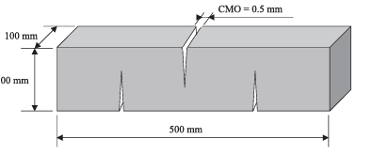
OBJECTIVES OF THE STUDY
Experimental Conditions:
Crack Mouth Opening (CMO) = 0.5 mm
Exposure duration = 1 year
Marine-like environment
Salt fog cycles and drying cycles
The study aimed to:
Examine corrosion development in cracked SFRC.
Determine whether corrosion causes concrete spalling.
Evaluate whether corrosion reduces fibre load-carrying capacity.
Study the effect of marine exposure on flexural behaviour.
Compare protected (sealed) and unprotected (open) cracks.
Fig 2. Crack Positions.

Slide 4
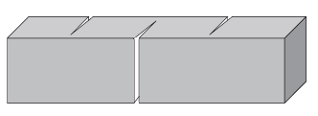
MATERIALS AND SPECIMEN PREPARATION
Concrete prisms:
Size = 10 × 10 × 50 cm
Concrete properties:
Water/Cement ratio = 0.60
Target compressive strength = 40 MPa
Steel fibres:
Hooked-end fibres
Length = 60 mm
Diameter = 0.8 mm
Two cement types were studied:
CEM I 52.5
CEM II 32.5
Exposure environment:
1 week salt fog
1 week drying
These were repeated for one year.
Purpose:
To simulate severe marine exposure conditions.
Fig 3. Position of Prisms in Fog Room.

Slide 5
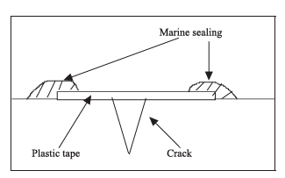
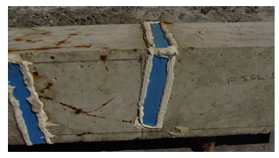
PROTECTION OF CRACKS & CORROSION SETUP
Half of the specimens were protected. Half were left exposed.
Protected specimens:
Protection system consisted of:
Plastic adhesive tape
Marine silicone sealant
Purpose:
To prevent chloride ingress through cracks.
Fig 4. Sketch of cracks protection.
Unprotected specimens:
Cracks remained directly exposed to:
Salt fog
Moisture
Oxygen
This enabled comparison of corrosion effects.
Fig 5. Cracks protection.

Slide 6
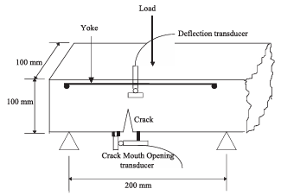
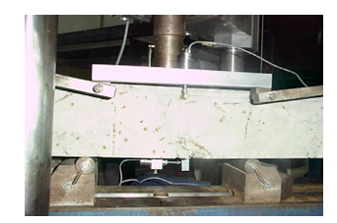
CRACKING PROCEDURE BEFORE EXPOSURE
Prisms were pre-cracked after curing.
Testing method:
Three-point bending
Span = 20 cm
Measurements:
Midspan deflection
Crack Mouth Opening (CMO)
Loading continued until:
CMO = 0.8 mm
After unloading:
Residual crack width ≈ 0.5 mm
This simulated realistic service cracks before exposure.
Fig 6. Sketch of the cracking of the prism.
Fig 7. Photograph of the cracking of the prism.

Slide 7
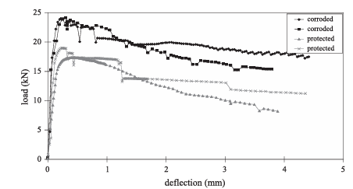
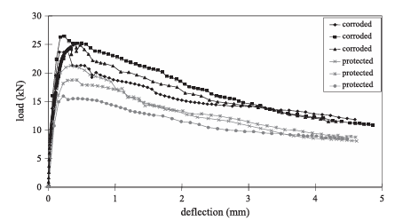
FLEXURAL TEST RESULTS AFTER CORROSION
After one year exposure:
Specimens were dried for 7 days.
Three-point bending tests were repeated.
Unexpected observation:
Corroded specimens showed higher flexural strength than protected specimens.
Load-deflection curves indicated:
No loss of fibre effectiveness
No brittle behaviour
Improved post-cracking resistance
This suggests corrosion was not severe enough to damage fibres.
Fig 8. Incidence of corrosion on fibres strength: cement CPA CEM I 52.5.
Fig 9. Incidence of corrosion on fibres strength: cement CPA CEM I 52.5 (continued).

Slide 8
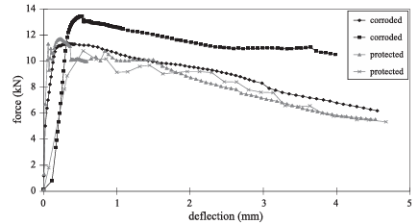
INTERPRETATION OF LOAD–DEFLECTION CURVES
The authors proposed three possible corrosion effects.
Type A:
Severe fibre corrosion
Expected:
Reduced peak load
More brittle behaviour
Type B:
Crack healing
Expected:
Higher peak load
Later return to normal response
Type C (Observed):
Light corrosion
Observed:
Increased peak load
Improved post-cracking behaviour
Conclusion:
The experimental curves matched Type C behaviour.
Fig 10. Incidence of corrosion on fibres strength: cement CPJ CEM II 32.5.

Slide 9
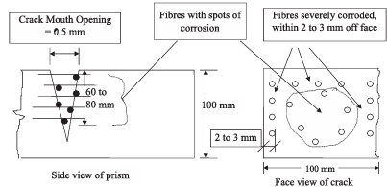
VISUAL OBSERVATIONS OF CORROSION
After testing, prisms were split and inspected.
Observations:
No concrete spalling
No bursting
No crack healing deposits
Severe corrosion only near exposed surfaces
Internal fibres showed only light corrosion
Corrosion penetration was limited.
The damage was much smaller than typically observed in reinforced concrete bars.
Fig 11. Corrosion of the fibres observed in the crack.

Slide 10
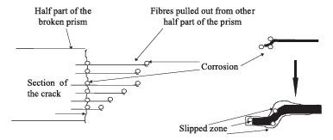
CORROSION MECHANISM
Corrosion was concentrated at:
Fibre emergence points
Hooked fibre ends
Reason:
Crack opening causes fibre pull-out.
This damages the fibre–concrete bond.
The loosened interface allows:
Moisture ingress
Oxygen access
Localized corrosion
However:
Corrosion remained shallow and did not significantly reduce fibre area.
Fig 12. Detail of corrosion observed on the fibres emerging from the crack section.

Slide 11
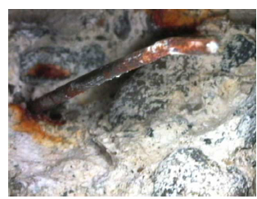
WHY DID STRENGTH INCREASE?
The authors rejected crack-healing as the explanation because:
No healing products were found
Load-deflection curves did not show healing behaviour
Proposed explanation:
Light corrosion roughened fibre surfaces.
Rougher fibres created:
Higher bond resistance
Greater friction during pull-out
As a result:
More load was required to pull fibres from concrete.
Hence flexural strength increased.
Fig 13. Photograph of the corroded fibre in the crack.

Slide 12
MAJOR FINDINGS
After one year of marine exposure:
No significant reduction in fibre cross-section.
No concrete spalling occurred.
Corrosion was localized near crack surfaces.
Crack regions below approximately 0.1 mm width showed almost no corrosion.
Fibre bridging capacity remained effective.
Slight corrosion increased bond and friction.
Flexural performance improved rather than deteriorated.
Observation | Finding
Spalling | Not observed
Fibre section loss | Negligible
Corrosion depth | Limited
Crack healing | Not observed

